Slide 1
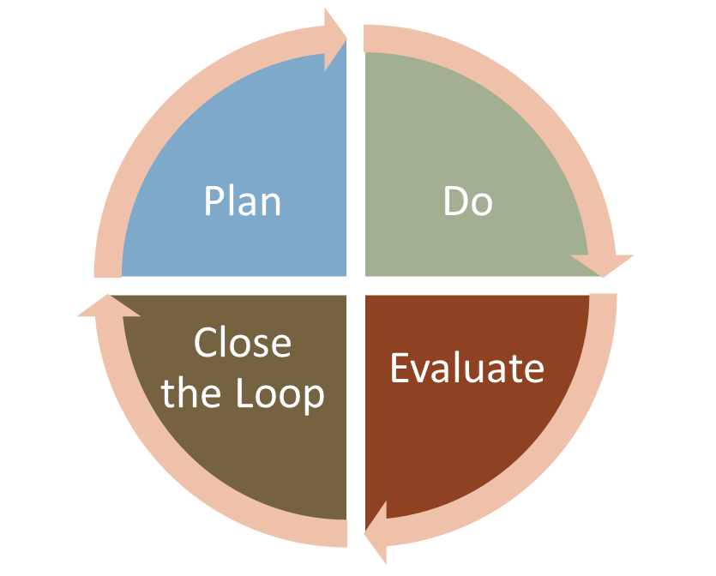
CLOSING THE LOOP
PECS – Director / Richard Davis
PECS – Market Research / Jan Kihm

Slide 2
Public Engagement Closing the Loop “Rules”
Promise to public is about process not outcome (all levels)
But, need to report back in a timely manner
Robust
Honest
Fair

Slide 3
Critical to acknowledge all issues
What was decided
What was recommended
What was heard
What was considered
Rationale
Trade-offs
Factors

Slide 4
Closing the loop at MnDOT
PUBLIC
PARTNERS
Stakeholders
INTERNAL
Teams
Governmental
Organizations
Public
General
Segments
Participants
Interact with public
Future projects
INTERNAL DEBRIEF EVALUATION GUIDE / INTERNAL SUMMARY

